Slide 1
Anagha Bhatkhande Varsha Mahajan
SDTM Special Purpose Domain
October 30, 2017

Slide 2
Agenda
01
Special Purpose Domain – DM SDTM
02
Understand Controlled Terminology
03
SDTM DM METADATA

Slide 3
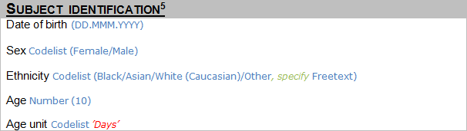
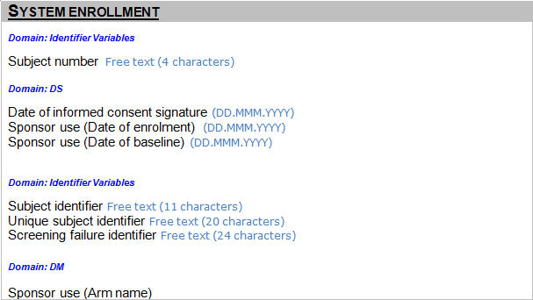
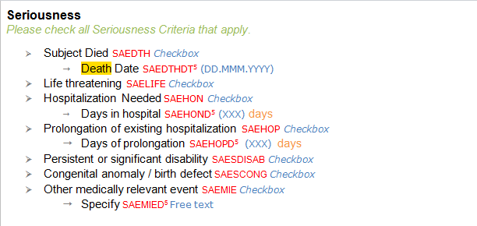
Annotated CRF Example
DM.BRTHDTC
DM.SEX
DM.SUBJID
DM.RACE
SUPPDM.RACEOTH
DM.RFICDTC
DM.AGE
DM.AGEU
DM.DTHFL
DM.DTHDTC
DM. USUBJID
If Yes, DM.ACTARMCD= “SCRNFAIL”
DM.ARMCD, DM.ACTARMCD

Slide 4
SDTM DM
One record per subject
Parent domain for all other observations for human clinical subjects
Set of essential standard variables that describe each subject in a study.
Subjects occasionally change sites during the course of a clinical trial.
USUBJID, SUBJID and SITEID should be used to handle the above problem, only one DM record should be submitted for the subject.
The values of ARM and ARMCD in DM must match entries in the Trial Arms (TA) dataset, except for subjects who were not fully assigned to an Arm.
For screen failures, ARMCD = “SCRNFAIL" and ARM = “Screen Failure”.
Screen Failure record may be reported in the Disposition dataset indicating occurrence of screen failure vent

Slide 5
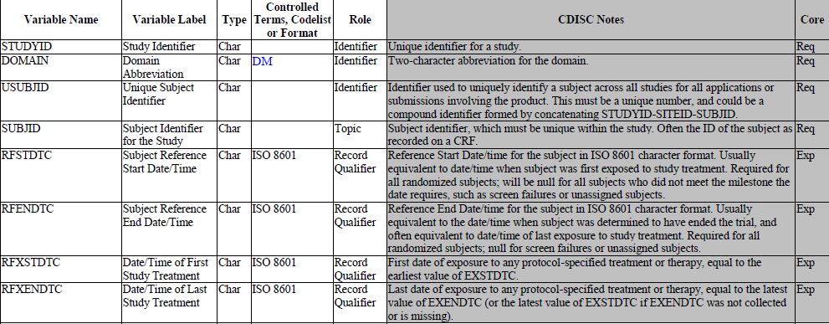
DM SDTM METADATA
Why do I need this when I have subjid?
Similar subject number can be used in different studies, for Pooling data from different studies we need the reference of each study
Every subject in a study must have a subject identifier (SUBJID)
These variables are applicable for interventional studies

Slide 6
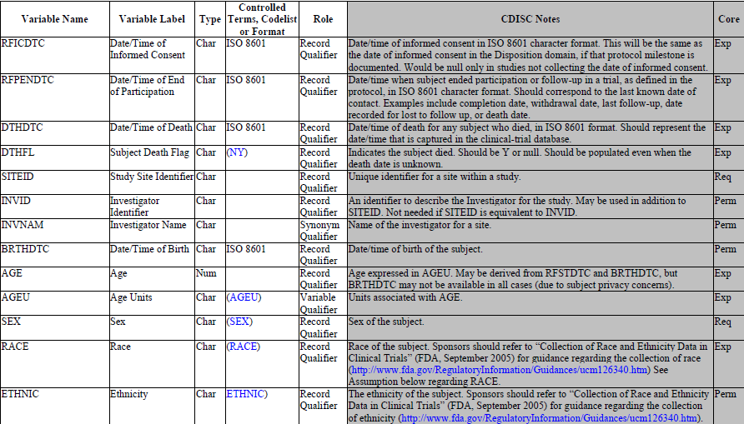
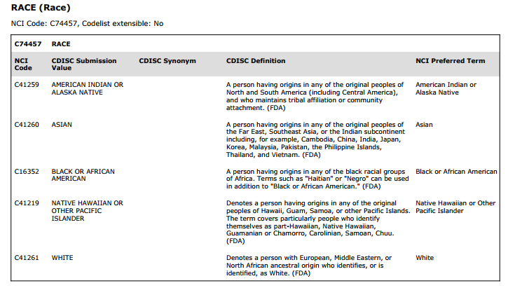
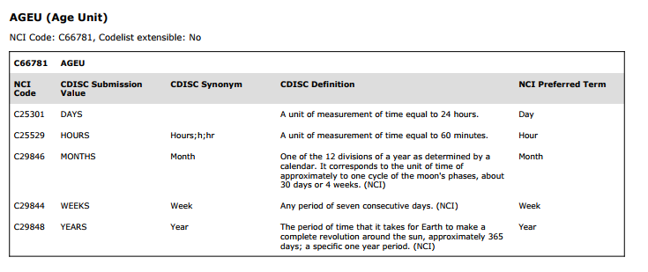
DM SDTM METADATA
Can I map the death date collected on “Seriousness page” in DTHDTC?
Subject may change Site during trial, DM should have a single record even in such casestrial.

Slide 7
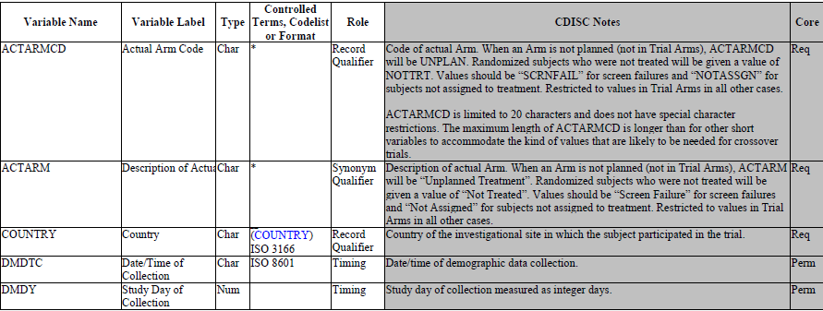
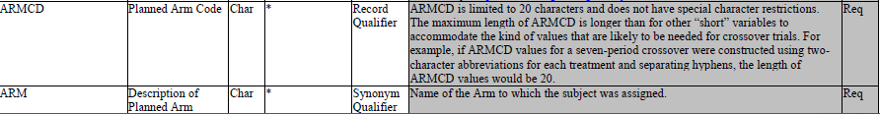
DM SDTM METADATA

Slide 8
End of Session

Slide 9
Anagha Bhatkhande Varsha Mahajan
Understand Controlled Terminology
October 31, 2017

Slide 10
Controlled Terminiology
Set of CDISC-developed or CDISC-adopted standard expressions (values)
Used with data items within CDISC-defined datasets
CDISC partners with NCI EVS to develop and support controlled terminology for all CDISC foundational standards (SDTM, CDASH, ADaM, SEND) and all CFAST Therapeutic Area standards.
https://evs.nci.nih.gov/ftp1/CDISC/SDTM/SDTM%20Terminology.pdf

Slide 11
About NCI EVS
Since 1997, National Cancer Institute Enterprise Vocabulary Services (EVS) has provided terminology content, tools, and services to accurately code, analyze and share cancer and biomedical research, clinical and public health information.
EVS creates, compiles, and cross-maps biomedical terminology needed by NCI and its community.

Slide 12
End of Session

Slide 13
Anagha Bhatkhande Varsha Mahajan
SDTM DM METADATA
October 30, 2017

Slide 14
METADATA Attributes as per Define.xml
The Variable Name (Up to 8 characters)
A descriptive Variable Label, (up to 40 characters), unique for each variable
The data Type (character or numeric)
The set of controlled terminology for the value or the presentation format of the variable (Controlled Terms, Codelist or Format)
The Origin of each variable (For Traceability)
The Role of the variable (Roles represent the categories of variables such as Identifier, Topic, Timing, or the five types of Qualifiers)
Comments or other relevant information about the variable

Slide 15
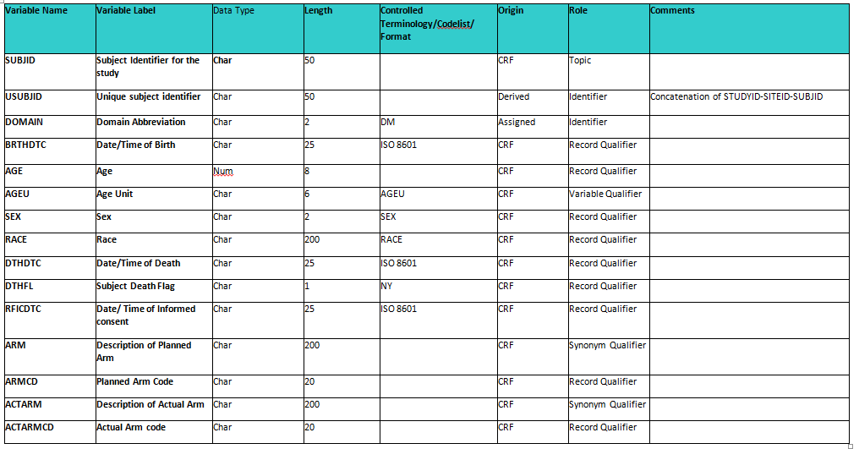
DM SDTM METADATA

Slide 16
DM DATA SNAPSHOT
STUDYID | SUBJID | USUBJID | SITEID | BRTHDTC | AGE | AGEU | SEX | RACE | DTHFL | DTHDTC | RFICDTC | ARM | ARMCD | ACTARM | ACTARMCD
XXXX | 001 | XXX-001-002 | 1 | 1980-01-12 | 36 | Years | M | ASIAN | N | . | 2016-01-01 | XYZ | A-1 | XYZ | A-1
XXXX | 002 | XXX-001-002 | 1 | 2000-10-06 | 16 | Years | F | BLACK OR AFRICAN AMERICAN | N | . | 2016-01-01 | XYZ | A-1 | XYZ | A-1
XXXX | 003 | XXX-002-003 | 2 | 1990-07-25 | 26 | Years | M | WHITE | Y | 2017-10-12 | 2016-01-01 | XYZ | A-1 | XYZ | A-1
XXXX | 004 | XXX-002-004 | 2 | 1999-03-13 | 17 | Years | F | Other | N |  | 2016-01-01 | XYZ | A-1 | XYZ | A-1

Slide 17
SUPPDM DATA SNAPSHOT
STUDYID | USUBJID | RDOMAIN | QNAM | QLABEL | QVAL | QORIG
XXXX | XXX-002-004 | DM | RACEOTH | Race, Other Specifys | BRAZILIAN | ASIAN

Slide 18
End of Session

